Slide 1
Network Theorems
Chapter 9 [DC]
Chapter 18 [AC]

Slide 2
9.4 NORTON’S THEOREM
2

Slide 3
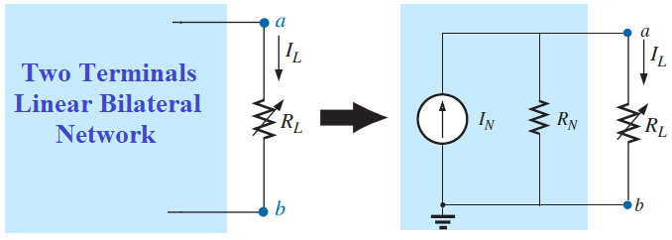
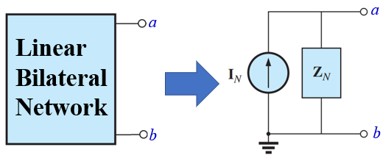
Statement of Norton’s Theorem
Any two-terminal, linear bilateral network can be replaced by an equivalent circuit consisting of a current source and a parallel resistance/impedance, as shown in the following figure.
R_{N}: Norton’s equivalent resistance
I_{N}: Norton’s equivalent current
Z_{N}: Norton’s equivalent impedance
I_{N}: Norton’s equivalent current
3

Slide 4
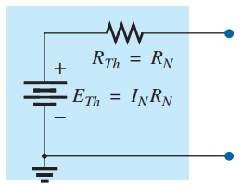
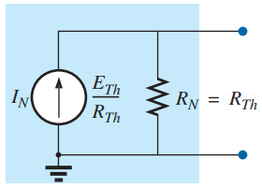

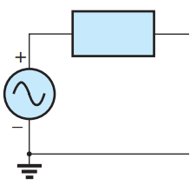
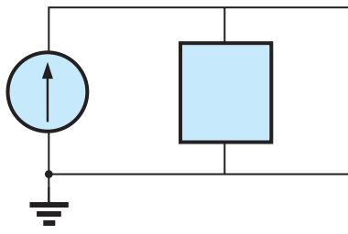
Conversion Between Thevenin and Norton’s Equivalent Circuit
Z_{Th} = Z_{N}
E_{Th}
E_{Th} = Z_{N}I_{N}
I_{N}
Z_{N}=Z_{Th}
Z_{Th}
4

Slide 5
Steps to Apply Norton’s Theorem
Step 1: | Remove that portion of the network where the Thévenin equivalent circuit is found.
Step 2: | Mark the terminals of the remaining two-terminal network.
Step 3: | Calculate R_{N}/Z_{N} by first setting all sources to zero (voltage sources are replaced by short circuits, and current sources by open circuits) and then finding the resultant resistance/impedance between the two marked terminals. (If the internal resistance/impedance of the voltage and/or current sources is included in the original network, it must remain when the sources are set to zero.)
Step 4: | Calculate I_{N} by first returning all sources to their original position and then finding the short-circuit current between the marked terminals. It is the same current that would be measured by an ammeter placed between the marked terminals.
Step 5: | Draw the Norton’s equivalent circuit with the portion of the circuit previously removed replaced between the terminals of the equivalent circuit.
Step 6: | Do the remaining required calculation
5

Slide 6
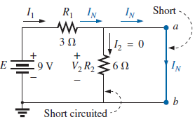
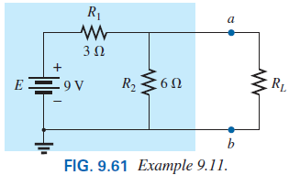
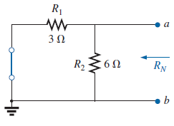

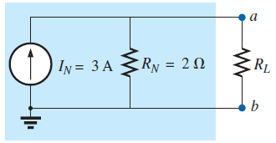
Example 9.11 [P364] Find the Norton equivalent circuit for the network in the shaded area in Fig. 9.61.
Step 3: Calculate R_{N} by first setting all sources to zero and then finding the resultant resistance between the two marked terminals (a and b).
Step 5: Draw the Norton equivalent circuit with the portion of the circuit previously removed replaced between the terminals of the equivalent circuit.
Step 1: Remove that portion of the network where the Norton equivalent circuit is found.
Step 2: Mark the terminals (such as a and b).
Step 4: Calculate I_{N} by first returning all sources to their original position then finding the short-circuit current between the marked terminals. (a and b).
6

Slide 7
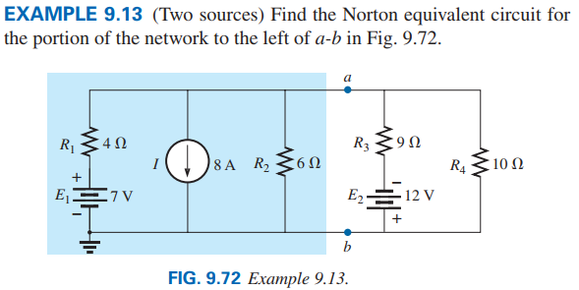
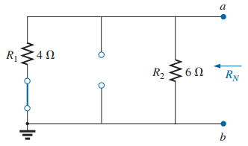
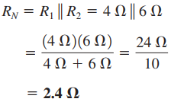
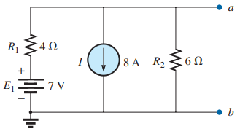
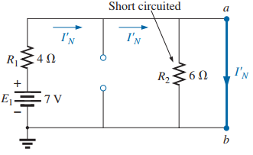

Step 3: Calculate R_{N}:
Step 4: Calculate I_{N}: Since there are two sources Superposition theorem has to be applied.
Step 1 and Step 2:
Consider 7 V:
7

Slide 8
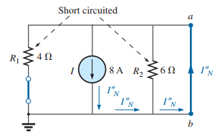
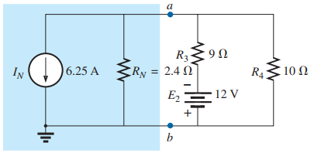

Consider 8 A:
Step 5: Draw the Norton equivalent circuit:
According to Superposition Theorem
8

Slide 9
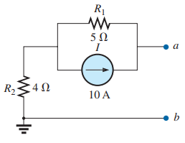
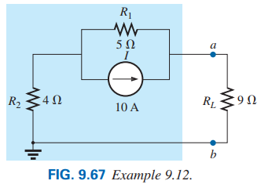
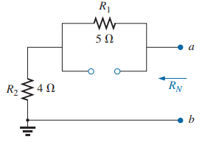
Example 9.12 [P365] Using the Norton Theorem to terminal a and b of Fig. 9.67, find the value of current which is passing through 9 Ω resistor.
Step 3: Calculate R_{N} by first setting all sources to zero and then finding the resultant resistance between the two marked terminals (a and b).
Step 1: Remove that portion of the network where the Norton equivalent circuit is found.
Step 2: Mark the terminals (such as a and b).
9

Slide 10
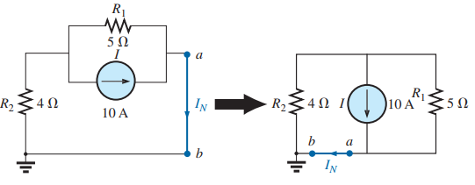

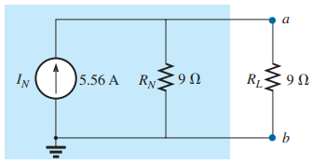
Step 4: Calculate I_{N} by first returning all sources to their original position then finding the short-circuit current between the marked terminals. (a and b).
Step 5: Draw the Norton equivalent circuit with the portion of the circuit previously removed replaced between the terminals of the equivalent circuit.
10

Slide 11
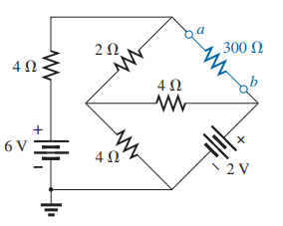
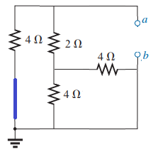
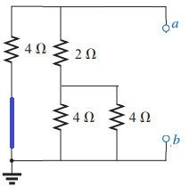
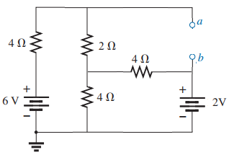
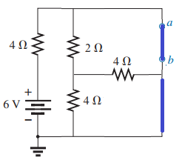
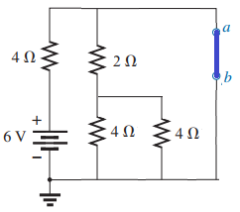
Problem 23 [P392] Find the Norton equivalent circuit for the portions of the networks in Fig. 9.136(b) external to branch a-b.
Step 3: Calculate R_{N}:
R_{N}
R_{N}
Step 1 and Step 2:
Step 4: Calculate I_{N}: Since there are two sources Superposition theorem has to be applied.
Consider 6 V:
I_{N1}
I_{N1}
11

Slide 12
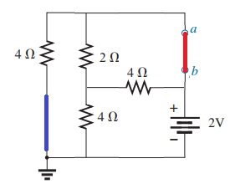
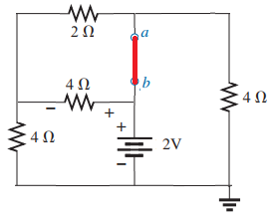
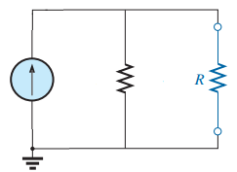
Consider 2 V:
I₂
I₄
According to Superposition Theorem
I_{N2}
I_{N2}
V₂
Step 5: Draw the Norton equivalent circuit:
I_{N}
R_{N}
2 Ω
300 Ω
0.75 A
Practice Book [Ch 9] Problem: 18 ~ 23
12

Slide 13
NORTON’S THEOREM [AC]
13

Slide 14
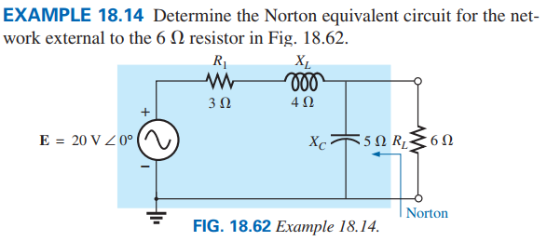

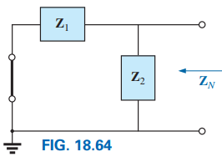
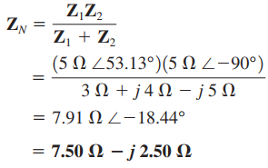


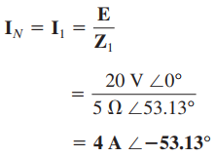
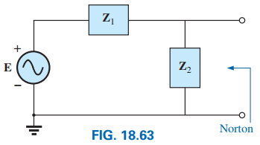
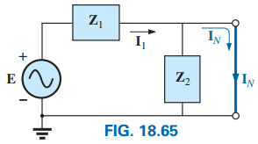
14

Slide 15
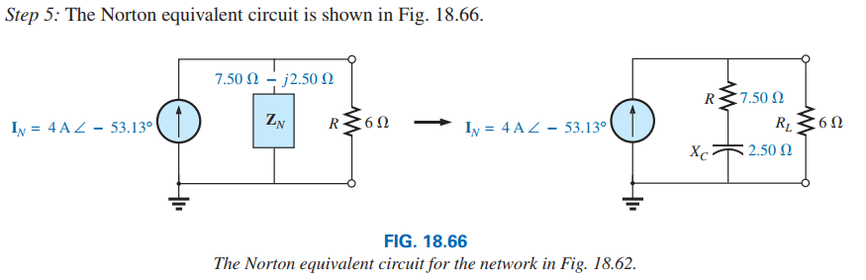
15

Slide 16
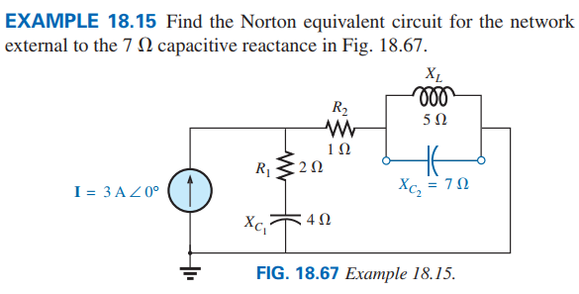

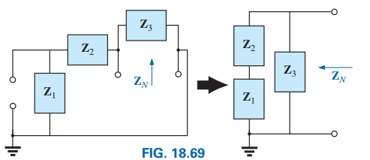


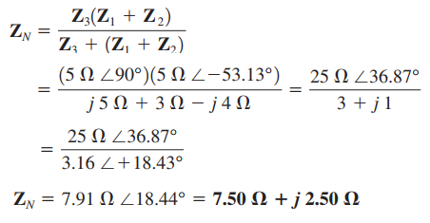
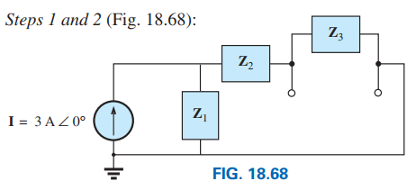
16

Slide 17
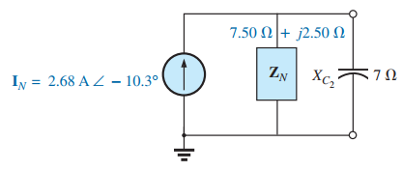
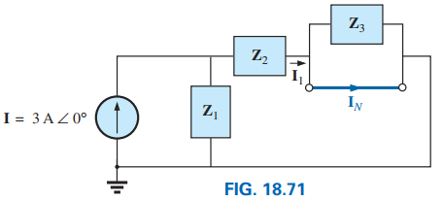
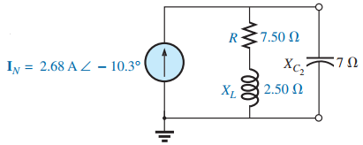
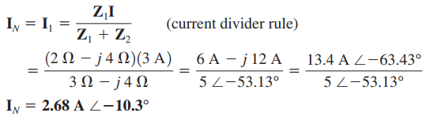
Practice Book Remaining Examples
And
Problem 26- 29 [Ch. 18]
17

Slide 18
9.5 MAXIMUM POWER TRANSFER THEOREM
18

Slide 19
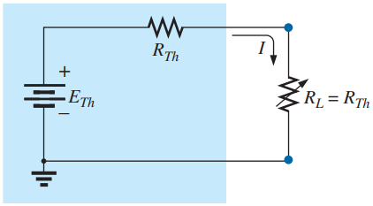




Statement of Maximum Power Transfer Theorem
A load will receive/consume/absorb maximum power from a network when its resistance is exactly equal to the Thévenin resistance of the network applied to the load. That is:
When R_{L} = R_{Th}, the maximum power delivered to the load can be determined by first finding the current:
Power can be calculated as follows:
19

Slide 20

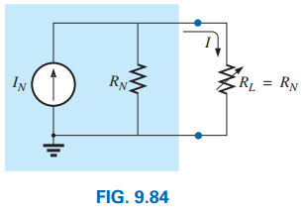

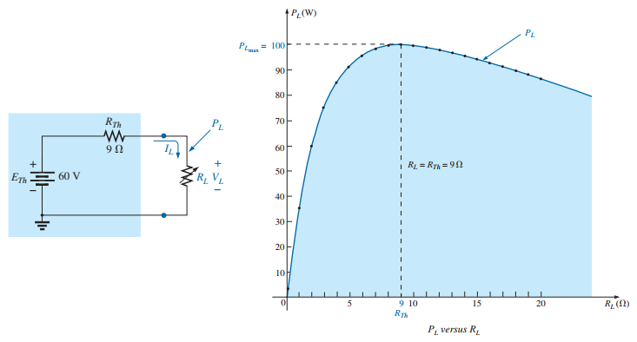
For the Norton equivalent circuit in Fig. 9.84, maximum power will be delivered to the load when
Power can be calculated as follows:
20

Slide 21
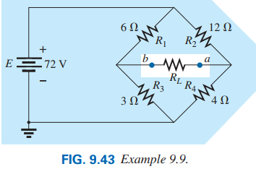



Example 9.5.1 For the following network , find the value of R_{L} for maximum power to RL and determine the maximum power to R_{L}.
Step 3: Calculate R_{Th} by first setting all sources to zero (voltage sources are replaced by short circuits, and current sources by open circuits) and then finding the resultant resistance between the two marked terminals (a and b).
Step 1: Remove that portion of the network where the Thévenin equivalent circuit is found.
Step 2: Mark the terminals (such as a and b) of the remaining two-terminal network.
21

Slide 22



Step 4: Calculate E_{Th} by first returning all sources to their original position and finding the open-circuit voltage between the marked terminals (a and b).
Step 5: Draw the Thévenin equivalent circuit with the portion of the circuit previously removed replaced between the terminals of the equivalent circuit.
22

Slide 23




Example 9.5.2 For the following network , find the value of R_{L} for maximum power to R_{L} and determine the maximum power to R_{L}.
Step 3: Calculate R_{Th}
Step 1 and Step 2: for Thévenin equivalent circuit
23

Slide 24




Step 4: Calculate E_{Th}
Since there are two sources Superposition theorem has to be applied.
Consider E₁ then E₂ = 0 V (shorted).
Step 5: Draw the Thévenin equivalent circuit
Consider E₂ then E₁ = 0 V (shorted).
24

Slide 25





Example 9.5.2
(a) Find the Norton equivalent circuit for the network external to the resistor R for the network in Fig. 9.127.
(b) find the value of R for maximum power to R and determine the maximum power to R.
Step 3: Calculate R_{N}
Step 5: Draw the Norton equivalent circuit:
Step 4: Calculate I_{N}
Step 1: and Step 2 for the Norton equivalent circuit.
a
Practice Book [Ch 9] Problem: 18 ~ 23
b
25

